Slide 1
Steam Games Recommender:
A Machine Learning Project
by Peter Witwer

Slide 2
How should I spend my free time?

Slide 3
You should consume more of our product.

Slide 4
An Overview of Recommender Systems
“The goal of a Recommender System is to generate meaningful recommendations to a collection of users for items or products that might interest them.”
Content Based Filtering
User - item based on a user’s preferences
Collaborative Filtering
Model Based
Item - item
Memory Based
User - user

Slide 5
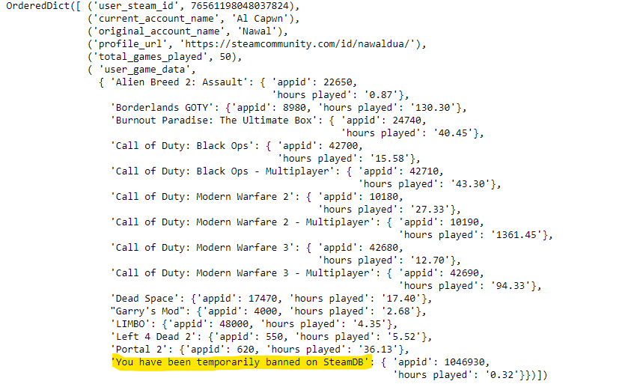
Gather user data using steam api
Steam id #
Current Account Handle
Initial Account Name (if available)
Dictionary for game data
Name of dictionary = name of the game
Appid = appid
Hours played = minutes played/60

Slide 6
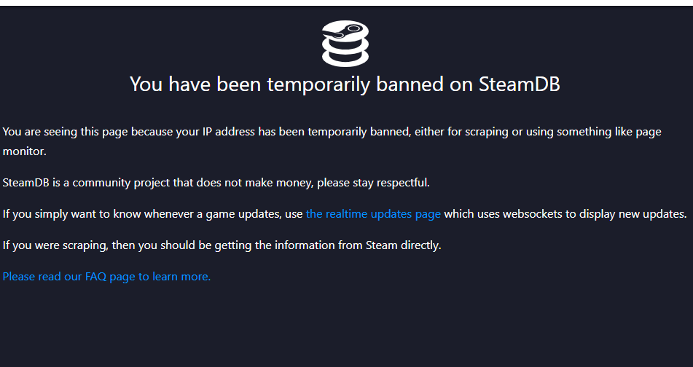
Maybe .sleep() would have prevented this?

Slide 7
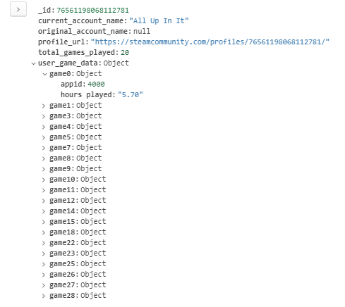
Sample MongoDB
Collection item
THethe
The plan is to have thousands of these

Slide 8
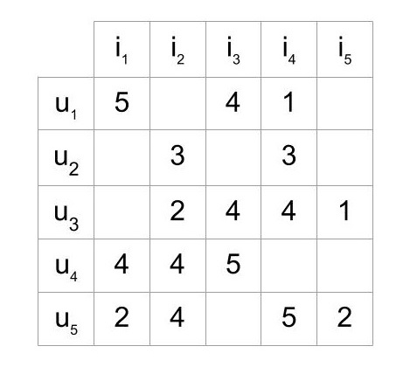
Constructing my own scipy.sparse.csr_matrix
Build a content-based recommendation filter using LightFM ML library.
Steam User - Video Game
Easy to identify users who invested many hours into a game.
Hours spent on a game more telling than written reviews
Potential to highlight patterns in users
Someone who owns many games of a certain genre, while having very few hours of gameplay.
Helpful in building other filters

Slide 9
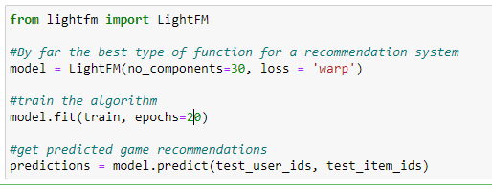
LightFM sample code
Loss = “warp”
Weighted Approximate-Rank Pairwise
Superior for recommendation systems
Most effective here because only positive values are present
“Maximizes the rank of positive examples by repeatedly sampling negative examples until rank violating one is found… optimise the top of the recommendation list”

Slide 10
Front-end application
Ideas:
Use html/bootstrap to display top recommendations on a webpage to search query your steam_id number
Sorted by genre, by active player count, by developer/publisher budget, by what friends have recently played, etc.
Scrape screenshots and photos for individual games, pull trailers in, showcase notable soundtracks
The steam store actually already does most of this
Offer more upfront explanations for why certain games are being recommended

Slide 11
Ethical Concerns
Do users want us to know how many hours they are putting into games?
Is everyone comfortable with companies building entire profiles on individual customers/users?
Do the benefits to the user outweigh the potential risks?
Are the “benefits” actually benefits?

Slide 12
Bibliography:
https://www.ime.usp.br/~jstern/miscellanea/seminario/Melville1.pdf
https://builtin.com/data-science/recommender-systems
Image
https://www.kaggle.com/danieliusv/steam-player-summaries?select=players_filtered.csv
https://files.realpython.com/media/rating-matrix.04153775e4c1.jpg
sdf

